Slide 1
Programming
Masoud Al Nayari

Slide 2
Outline
Programs and Programming
Programming Languages
OOP
Fundamental Concepts of OOP
Classes and Objects
Fields and Attributes
Methods, Parameters, and Return Values
Constructors
Data Types

Slide 3
Programs and Programming
A program is a set of instructions that tell the computer how to execute a certain task.
Programming is the process of making or writing a program.

Slide 4
Programming Languages
Computers understand only binary (0 and 1) codes.
Programming languages are the tools programmers use to write programs.
They help programmers in translating binary codes into human-readable language.
There are many types of programming and programming languages.

Slide 5
Programming Languages (2)
Some of the famous programming languages:
Python
Java
C#
C++
JavaScript
R
PHP
Kotlin
Swift

Slide 6
Object-oriented Programming (OOP)
Type of programming
It relies on objects and classes
Object Oriented programming (OOP) is a programming paradigm that relies on the concept of classes and objects. It is used to structure a software program into simple, reusable pieces of code blueprints (usually called classes), which are used to create individual instances of objects. There are many object-oriented programming languages including JavaScript, C++, Java, and Python.
Doherty. E., What is Object Oriented Programming? OOP Explained in Depth, From https://www.educative.io/blog/object-oriented-programming

Slide 7
Fundamental Concepts of OOP
Objects
Classes
Fields and Attributes
Methods
Constructor
Parameter
Return Value

Slide 8
Fundamental Concepts of OOP (2)
An objects is a thing from the real world.
Planet Earth, pacific ocean, University X, student Y, etc..
A class is like a blueprint of an object.
Planet class, ocean class, university class, etc..
A field is a variable that represents a property of an instance of a class.
Fields, attributes and properties are used interchangeably in OOP.

Slide 9
Fundamental Concepts of OOP (3)
Methods are like functions. They define the behaviour of objects they are attached to.
A constructor is a special type of method that is used to create and initialize new instances of the object. They have the same name as the class name.
A parameter is a special variable that is used in functions to pass information.
A return value is a value that is returned by a non-void function after it completes its tasks.

Slide 10
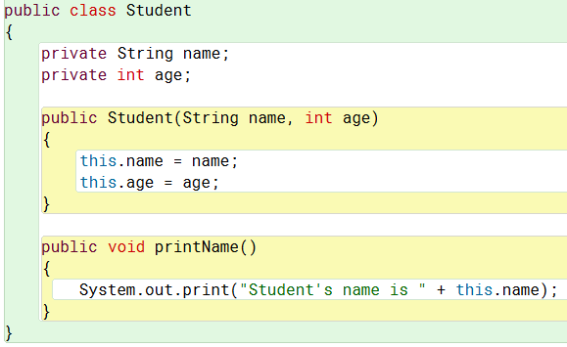
Classes in Java, C#
public class ClassName
{
Fields
Constructor
Methods
}

Slide 11
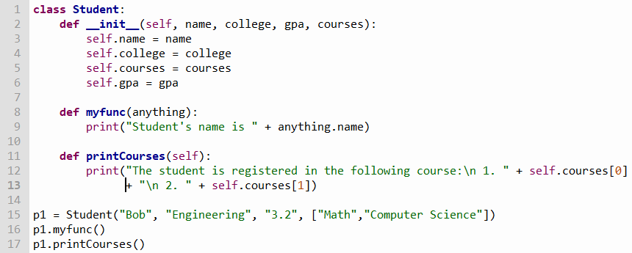
Classes in Python
Class
Constructor
Fields
Methods
Object Instance

Slide 12
Fields and Attributes
Fields represent properties of an object and attributes can be understood as the values stored in those fields.
Object instances have their own attributes.
Instantiating an instance of a class in Java for example:
Student ahmed = new Student (“Ahmed”, 30);
Student zz = new Student (“zz”, 20);
Student ahmed has his own “attributes”; a name (“Ahmed”) and an age of 30. These attributes define the state of object ahmed.

Slide 13
Methods, Parameters, Return Values

Slide 14
Constructors

